Slide 1
Innovation of the Content of Academic English Courses at the University of West Bohemia (UWB)
Svatava Heinlová
Jitka Hamarová
Jaroslava Presslová
Věra Polanová

Slide 2
Contents:
Introduction to the project
Methods and strategies
Example of innovated materials
Summary and conclusion

Slide 3
Methods and Strategies
Contents:
− Target group
− Creating new units in five steps
− Context: Mathematics
− Links
Aim:
− To inform about the individual steps
− To provide a possible manual

Slide 4
Step 1: Target Group
https://www.pngfuel.com/free-png/nfhfr

Slide 5
Step 1: Target Group
Subjective data - level of English, popular/useful/necessary topics:
− Essays and presentations (Applied Sciences)
− Needs analysis questionnaire
−Level of English according to CEFR – Oxford tests
Objective data - study programmes:
− Portal + Academic Departments
− Courseware

Slide 6
Step 2: Gathering Information
Search terms 1:
Math overview: “Map of Mathematics”
Technical collocations: “Pythagoras' theorem”, “Unstable recursions”, “Fractal geometry”, “Math coursebook”…
Terminology: “Math terminology”, “Math and Geometry vocab”, Math terms - list
Levels: “Math Curriculum in various countries”,
“Teaching Mathematics at secondary level”

Slide 7
Step 2: Gathering Information
Search terms 2:
Warm-up: “Interesting facts about Math”, “Interesting Math problems”, “Fibonacci numbers”
Importance of Math: “Miscalculations resulting in disasters”, “Impressive engineering projects”
Math can be fun: “Human calculator”, “Math tricks for fast calculation”

Slide 8
Step 2: Gathering Information
Searching for texts and videos:
Web of Science, Collins COBUILD online, edX, TED talks, How Stuff Works, Coursera,
You Tube, Math is Fun, How Things Work, EU statistics
Top universities: Harvard, University of Tokyo, Massachusetts Institute of Technology

Slide 9
Step 3:
Adjusting the Level of English
roadtogrammar.com/textanalysis/
cefr.duolingo.com/
languageresearch.cambridge.org/wordlists/text-inspector
Demo text

Slide 10
Step 4: Planning
Adjusting the existing syllabus
Brainstorming → Outline

Slide 11
Step 5: New Units
Creating the units: student-centered, communicative, coherent, all skills involved
Consultations with content teachers
Proofreading
Recordings
Adjusting layout
Piloting

Slide 12
Example of Innovated Materials
https://unsplash.com/photos/OLwoFZ_g-ig

Slide 13
Study Shows Teen Pregnancy Drops Significantly After Age 19
A new study reveals teen pregnancy rates drop significantly after age 19.
The startling correlation was reported after a 5 year study of millions of family planning centers nationwide. The research team was led by Dr. Sandra McKinnon. (…)
“Our study found that teen pregnancy rates are nearly non-existing when a woman reaches the age of 20,” McKinnon said. “If you encourage your adolescent to abstain from sexual intercourse until they reach this age, the chances of them becoming teen mothers are incredibly slim.” (…)

Slide 14
Endless Curiosity:
The Science of Fake News
https://www.youtube.com/watch?v=BIv9054dBBI

Slide 15
An Activity: Description
rumors
hoaxes
propaganda
misinformation
social network
hashtag
bot
meteorologist
weather
indiscriminately
loud‑mouthed bot
junk
headline
Google

Slide 17
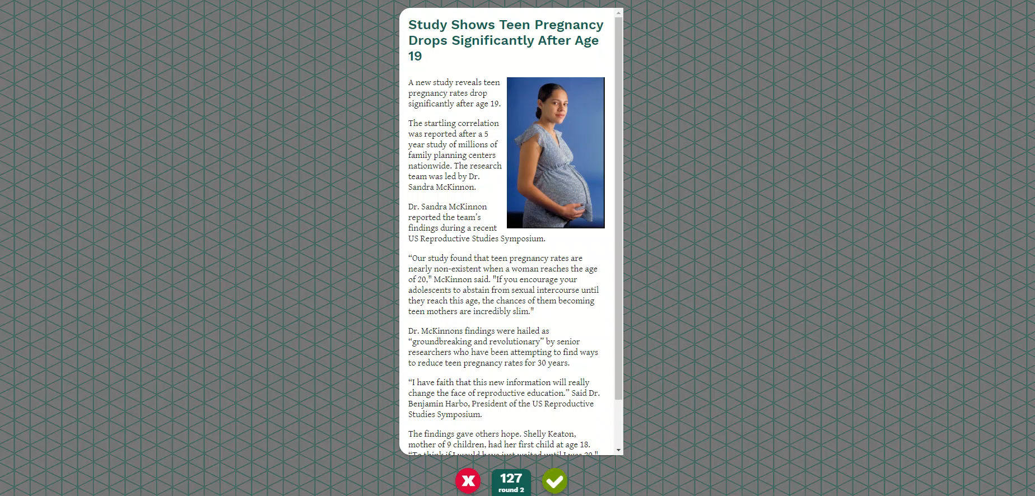
https://www.youtube.com/watch?v=H9e0RIhgOlU

Slide 18
Factitious
https://unsplash.com/photos/vdXMSiX-n6M

Slide 19
Summary
Innovation of existing programs of Academic English 1 (AEP1) and Academic English 2 (AEP2) for students of the Faculty of Applied Sciences
Methods used
Examples
Piloting and evaluation

Slide 20
Conclusion
Mgr. Svatava Heinlová Ph.D. heinlova@ujp.zcu.cz
Mgr. Jitka Hamarová
jhamarov@ujp.zcu.cz
Mgr. Jaroslava Presslová jpress@ujp.zcu.cz
Mgr. Věra Polanová
polano@ujp.zcu.cz

